Slide 1
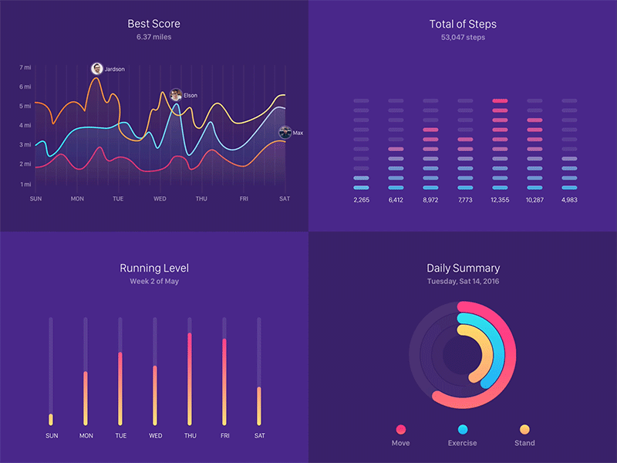
SQL Sunday
D211 Advanced SQL for Data Analytics with Tableau
Postgres database
Notes:
SQL Sunday presentation for D211.

Slide 2

SQL Sunday D211
First three Sundays
each month at 6:30 pm Eastern time
URL: wgu.webex.com
Mtg ID: 1202139260
Password: MNkF2iJW7j3
First three Sundays
each month at 6:30 pm Eastern time
URL: wgu.webex.com
Mtg ID: 1202139260
Password: MNkF2iJW7j3
Notes:
MEETING NUMBER: 120 213 9260
MEETING PASSWORD: MNkF2iJW7j3
Occurs First Three Sundays of each month at 4:30pm Mountain time for 1 hour.
This is the meeting information. We will meet at the same time with the same meeting number and Password for the first three Sundays of each month. On the fourth Sunday of the month, I will not present but record the items we discussed and send out the recording and the PowerPoint slides.

Slide 3

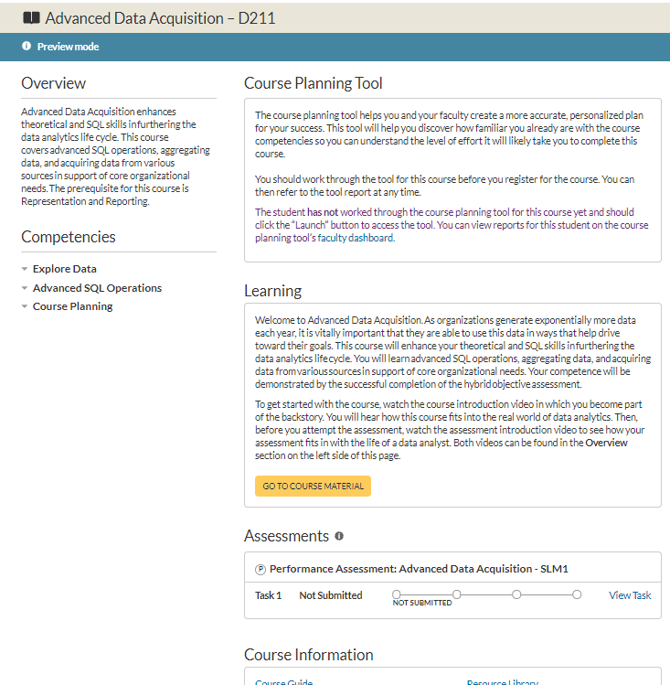
Notes:
Before we start discussing JOINs be aware of the following TIPs, TRICKs, and TRAPs.

Slide 4
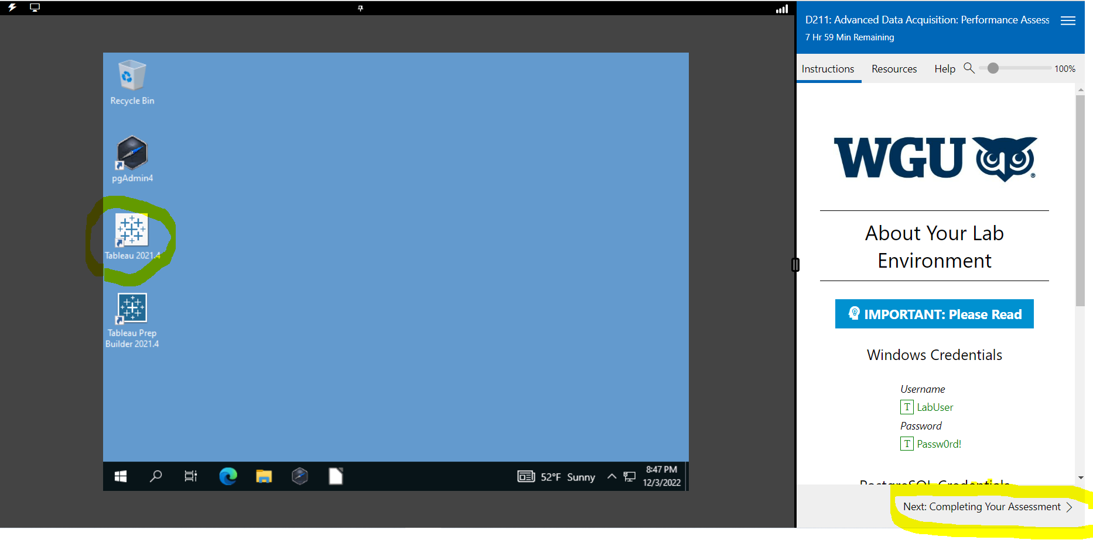
On the left Bringing PgAdmin back to life and Saving your session
On the right side, click the three parallel bars to save your session.’
Bringing PgAdmin back to life and Saving your session.
Notes:
Upper left: bring PgAdmin back to life with Lightning bolt or Display. Upper right: Save your session.

Slide 5
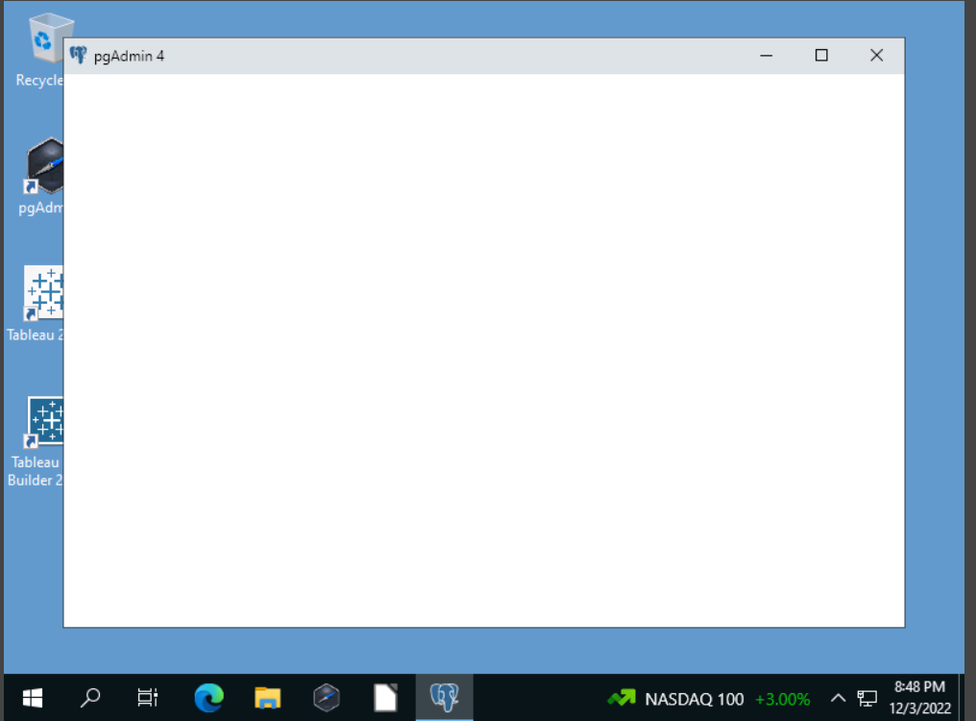

Slide 6
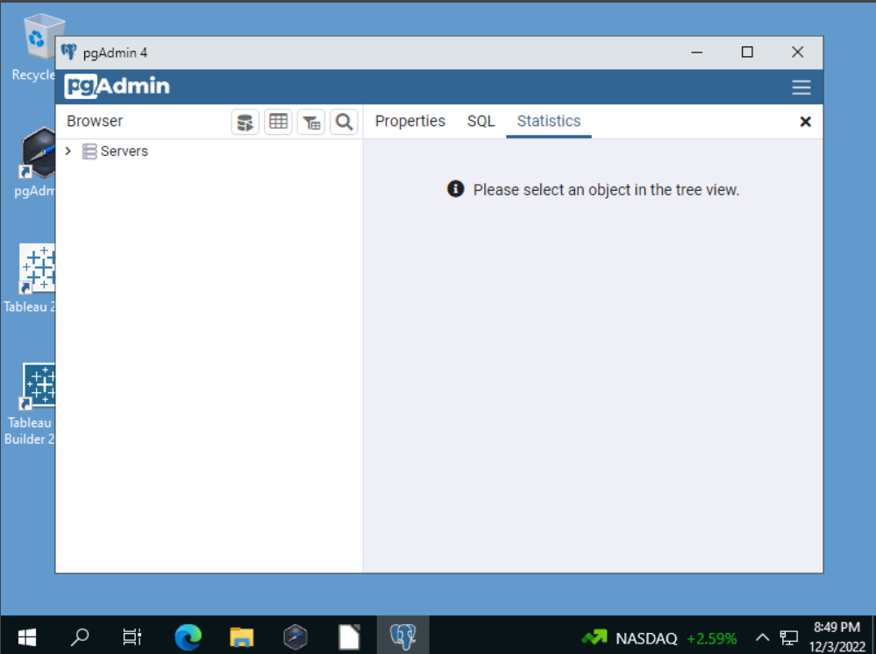

Slide 7
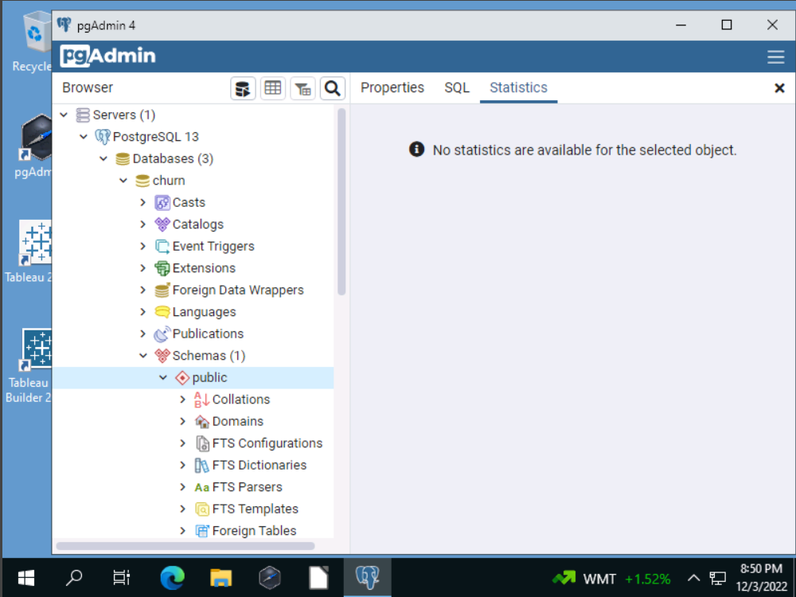

Slide 8
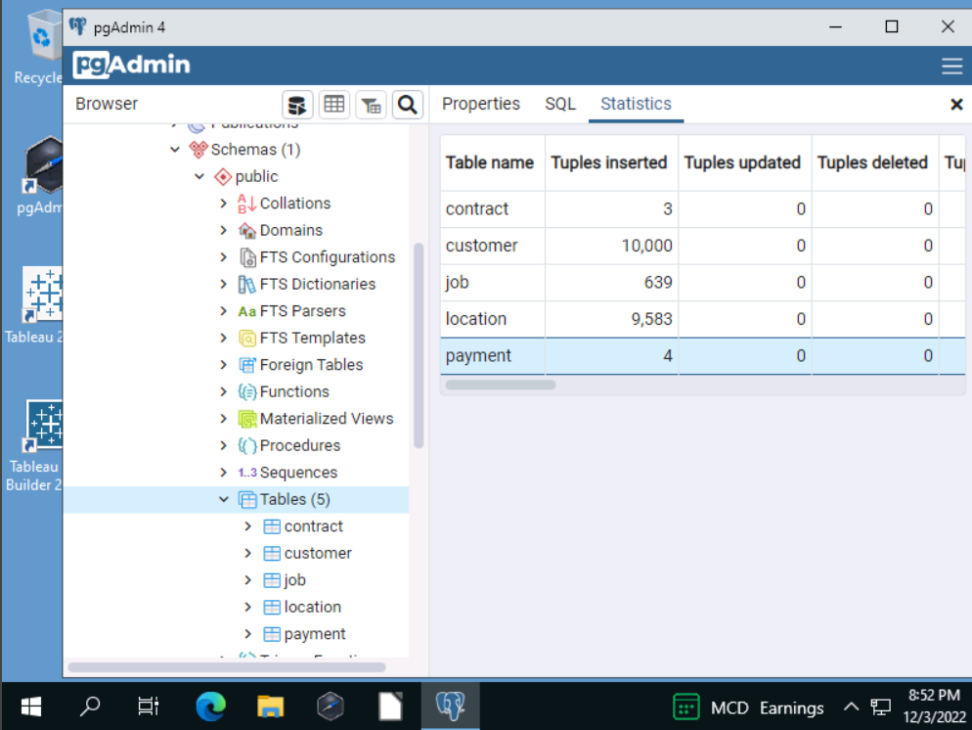

Slide 9
The data analyst’s job does not end once the data has been analyzed. A vital skill for data analysts is to represent and report the data to stakeholders. In this task, you will demonstrate your ability to identify actionable insights from data and communicate them using effective storytelling methods.
This task consists of three parts:
In part 1, you will use SQL and a business intelligence tool to create data dashboards to support executive decision-making. Your dashboards should enable leaders to answer a specific research question on an organizational need. It is recommended, but not required, that the business intelligence tool be Tableau.
Your dashboard will integrate data from two sources: 1. Provided data set: There are tables in the Churn database located on Labs on Demand.
The join must either be:
The external file to one or more tables OR you may create a table for the external file and import the data then join.
THE RUBRIC REQUIREMENTS

Slide 10

2. Your Additional data set: You will identify an external, public data set as an additional data set for your dashboard. This data set should contain data and variables that complement the data set you chose from the provided options and should enhance the insights you can gain from the provided data set. Recommended sources include U.S. census data, Kaggle, or other public data repositories. You are responsible for ensuring that you have the rights to use the data set.
In part 2, you will give a simulated presentation to a panel of peers. You will describe the use of SQL in preparing the data from the two data sets for the analysis and then demonstrate the functionality of the SQL scripts and other codes that supported the creation of the dashboards.
In part 3, you will write a reflection paper to outline the organizational need and summarize the findings from the analysis.
Refer to the data dictionary for your chosen provided data set for additional background information about the audience of your data representations.
THE RUBRIC REQUIREMENTS

Slide 11
THE RUBRIC REQUIREMENTS
Your submission must be your original work. No more than a combined total of 30% of the submission and no more than a 10% match to any one individual source can be directly quoted or closely paraphrased from sources, even if cited correctly. The similarity report that is provided when you submit your task can be used as a guide.
Tasks may not be submitted as cloud links, such as links to Google Docs, Google Slides, OneDrive, etc., unless specified in the task requirements. All other submissions must be file types that are uploaded and submitted as attachments (e.g., .docx, .pdf, .ppt).
To work on this task, you must follow the link "D211 Data Sets and Associated Dictionaries" in the Web Links section to the LoDs PostgreSQL lab environment. In this environment, you will be able to write and test your PostgreSQL code and access the databases to complete this task.
Part 1: Data Dashboards
A. Provide a copy of your dashboards that support executive decision-making.
1. Provide both data sets that serve as the data source for the dashboards.
2. Provide step-by-step instructions to guide users through the dashboard installation.
3. Provide clear instructions to help users navigate the dashboards.
4. Provide a copy of all SQL code and other code supporting the dashboards.

Slide 12
Part 2: Demonstration
B. Provide a link to a Panopto multimedia presentation in which you present the dashboards to an audience of data analytics peers. You should do all of the following in your presentation:
1. Describe the technical environment used to create the dashboards.
2. Demonstrate the functionality of the dashboards.
3. Explain the SQL scripts used to support the creation of the dashboards.
4. Explain how the data streams were prepared to support the analysis.
5. Describe how data were aligned with other data points.
6. Demonstrate how the databases were created.
7. Explain how referential integrity was enforced in the database.
Note: The audiovisual recording should feature you presenting the material on screen (i.e., not in voice-over or embedded video) and should simultaneously capture both you and your multimedia presentation.
Note: For instructions on how to access and use Panopto, use the "Panopto How-To Videos" web link provided below. To access Panopto's website, navigate to the web link titled "Panopto Access," and then choose to log in using the “WGU” option. If prompted, log in using your WGU student portal credentials, and then it will forward you to Panopto’s website.
To submit your recording, upload it to the Panopto drop box titled “XX.” Once the recording has been uploaded and processed in Panopto's system, retrieve the URL of the recording from Panopto and copy and paste it into the Links option. Upload the remaining task requirements using the Attachments option.

Slide 13
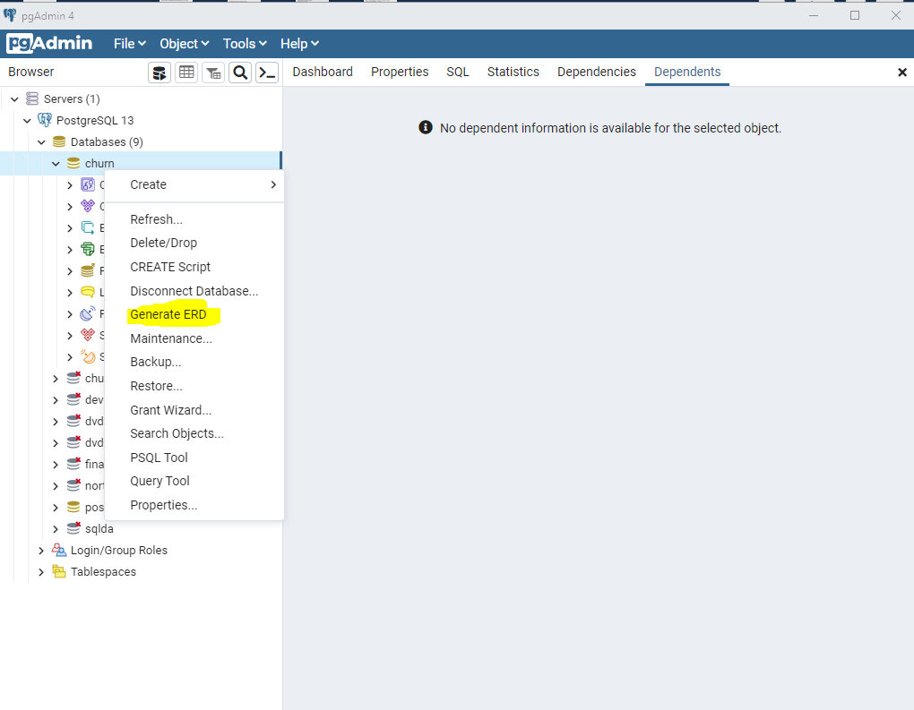

Slide 14
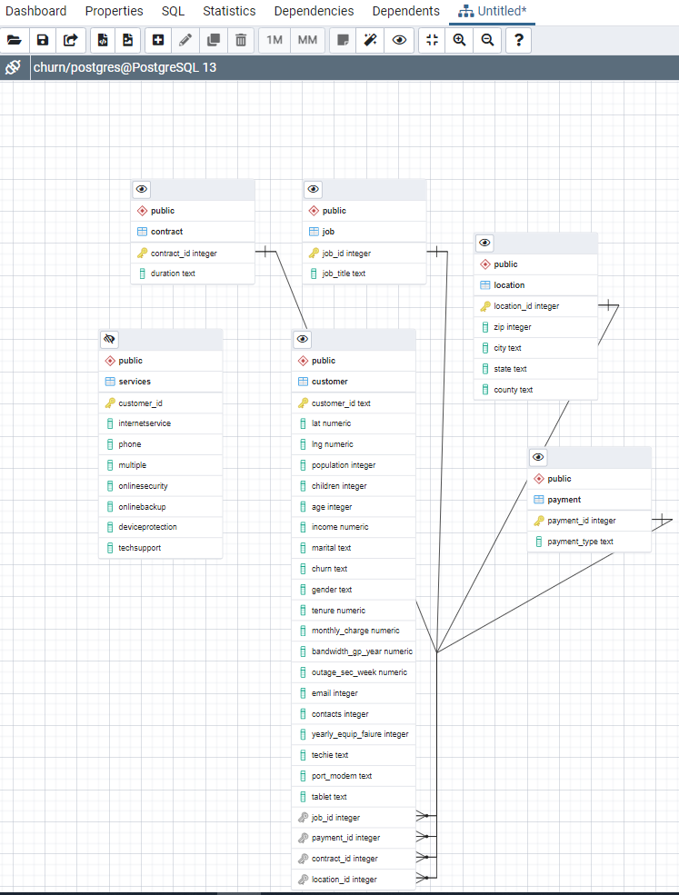
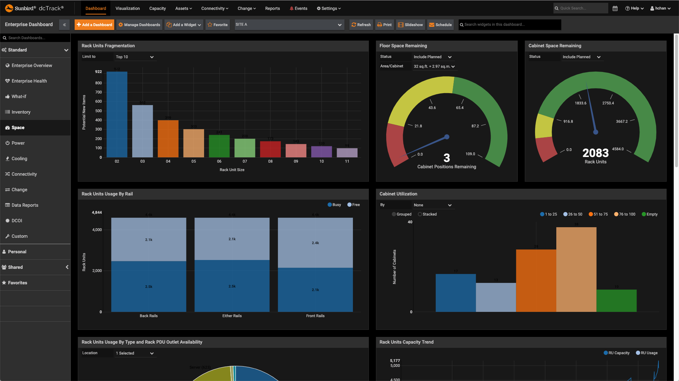
https://www.pgadmin.org/docs/pgadmin4/development/erd_tool.html
Using the ERD tool in
PgAdmin. See the document
Below for more information.
Notes:
PgAdmin does all the work for you.

Slide 15
Part 3: Report
C. Write a report to outline the data exploration, use of advanced SQL operations, and the analysis of the data. Do the following as part of your report:
Explain how the purpose and function of your dashboard aligns with the needs outlined in the data dictionary associated with your chosen data set.
There is not a data dictionary. It needs to be rewritten to say, inspect the Churn database and the five tables. How are they related among themselves and then to the external dataset that you are using?
2. Justify the selection of the business intelligence tool you used.
3. Explain the steps used to clean and prepare the data for the analysis.
4. Summarize the steps used to create the dashboards.
5. Discuss the results of your data analysis and how it supports executive decision-making.
6. Discuss the limitation(s) of your data analysis.
D. Record the web sources used to acquire data or segments of third-party code used to support the application. Ensure the web sources cited are reliable.
E. Acknowledge sources, using in-text citations and references, for content that is quoted, paraphrased, or summarized.
F. Demonstrate professional communication in the content and presentation of your submission.

Slide 16
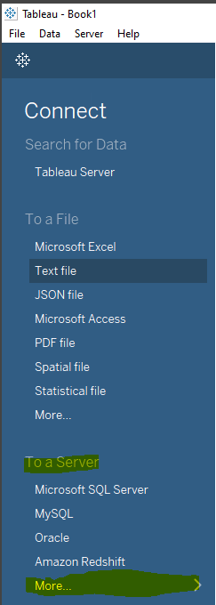
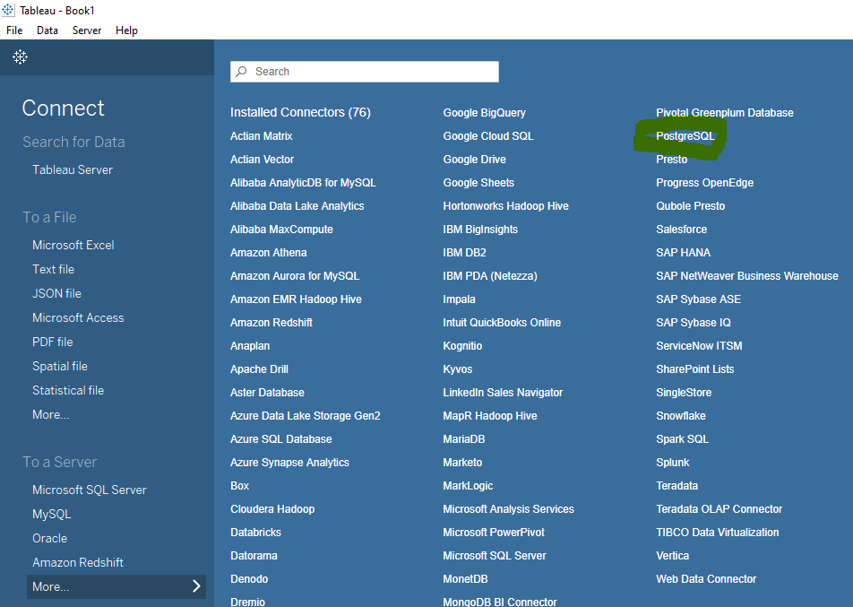
Notes:
Here is an example of the db-fiddle.com environment. You can use db-fiddle.com in virtually any web browser. Remember to save your work in notepad.

Slide 17
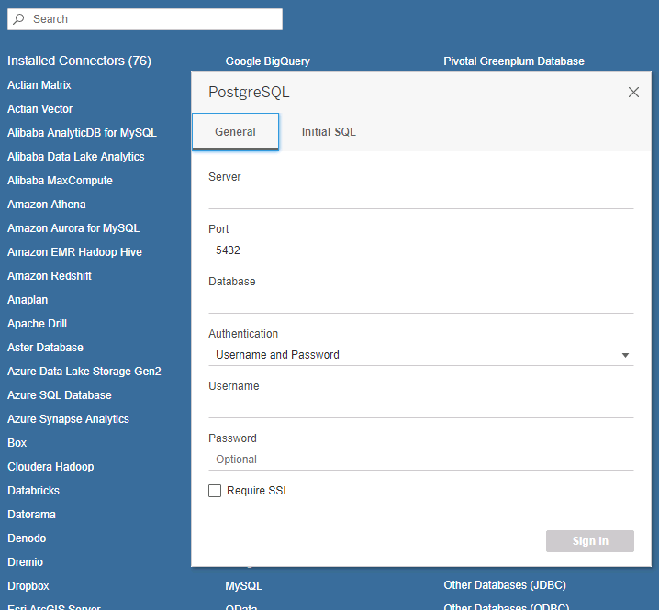
Notes:
Here is an example of the db-fiddle.com environment. You can use db-fiddle.com in virtually any web browser. Remember to save your work in notepad.

Slide 18
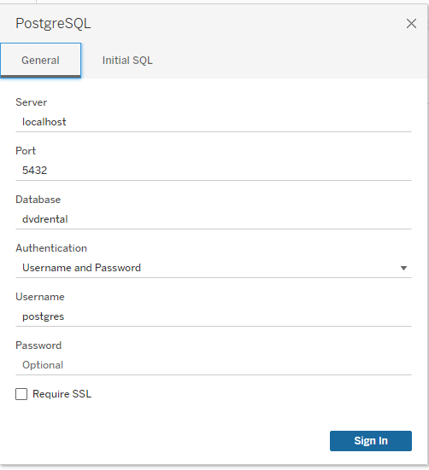
Accessing Postgres
from Tableau
Credentials are on the
Right side of the screen
In LODs.
Server: localhost
Port: 5432
Database: churn
Username: postgres
Password: Passw0rd!
Notes:
Here is an example of the db-fiddle.com environment. You can use db-fiddle.com in virtually any web browser. Remember to save your work in notepad.

Slide 19
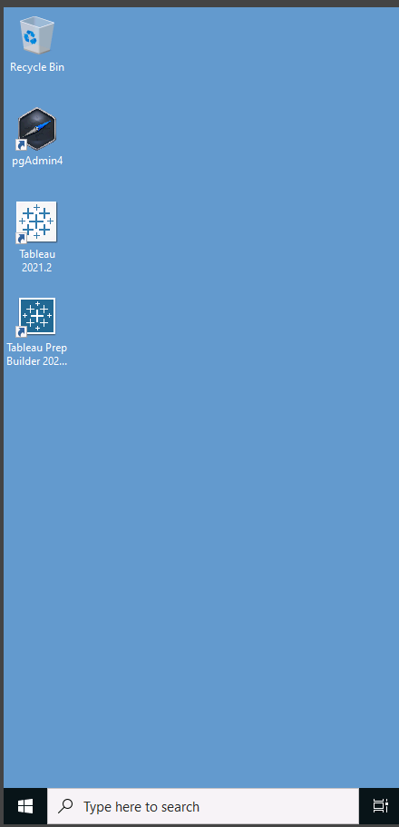
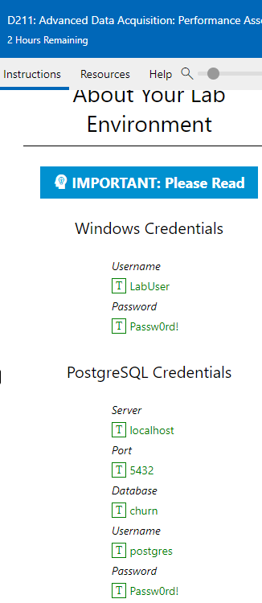
Accessing Postgres
from Tableau
Credentials are on
The Right side of
the screen
In LODs.
Notes:
Here is an example of the db-fiddle.com environment. You can use db-fiddle.com in virtually any web browser. Remember to save your work in notepad.

Slide 20
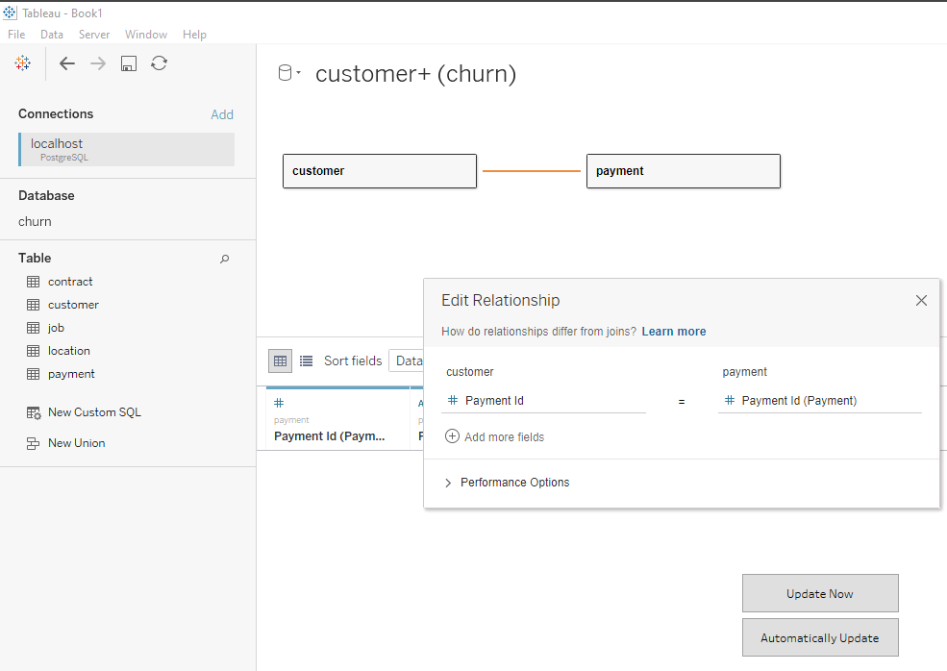
Notes:
Here is an example of the db-fiddle.com environment. You can use db-fiddle.com in virtually any web browser. Remember to save your work in notepad.

Slide 21
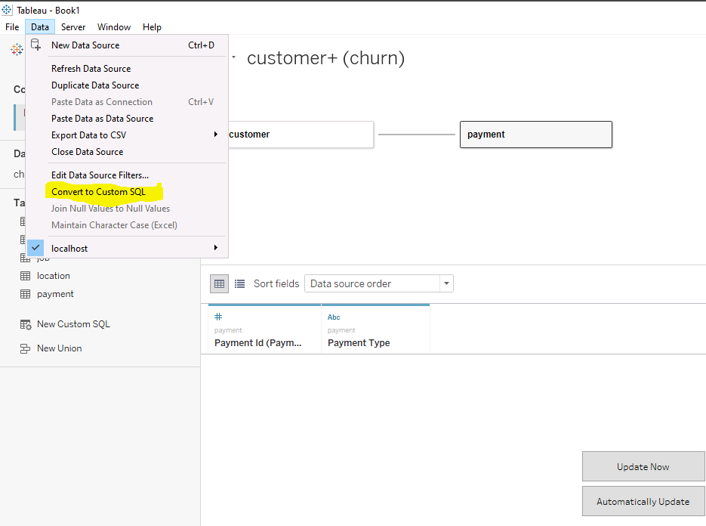
Notes:
Here is an example of the db-fiddle.com environment. You can use db-fiddle.com in virtually any web browser. Remember to save your work in notepad.

Slide 22
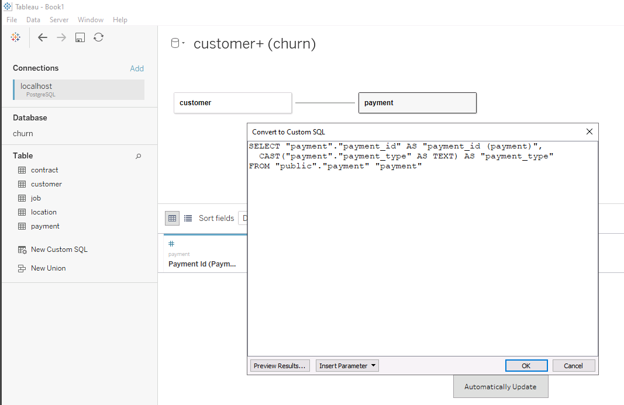
Notes:
Here is an example of the db-fiddle.com environment. You can use db-fiddle.com in virtually any web browser. Remember to save your work in notepad.

Slide 23
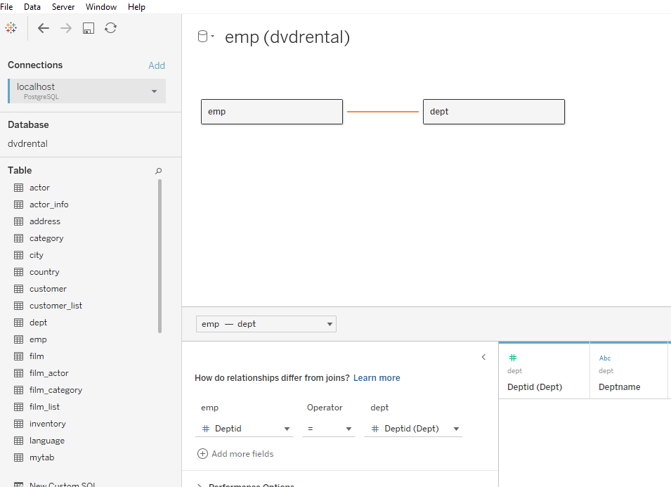
Once connected, drag the tables you want to work with.
https://help.tableau.com/current/pro/desktop/en-us/customsql.htm
Notes:
Here is an example of the db-fiddle.com environment. You can use db-fiddle.com in virtually any web browser. Remember to save your work in notepad.

Slide 24
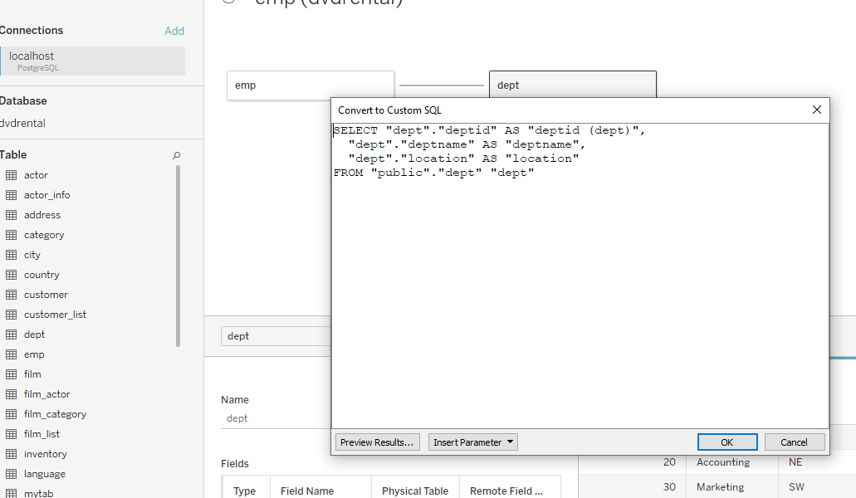
CREATING A CUSTOM SQL QUERY IN TABLEAU
https://help.tableau.com/current/pro/desktop/en-us/customsql.htm
Notes:
Here is an example of the db-fiddle.com environment. You can use db-fiddle.com in virtually any web browser. Remember to save your work in notepad.

Slide 25
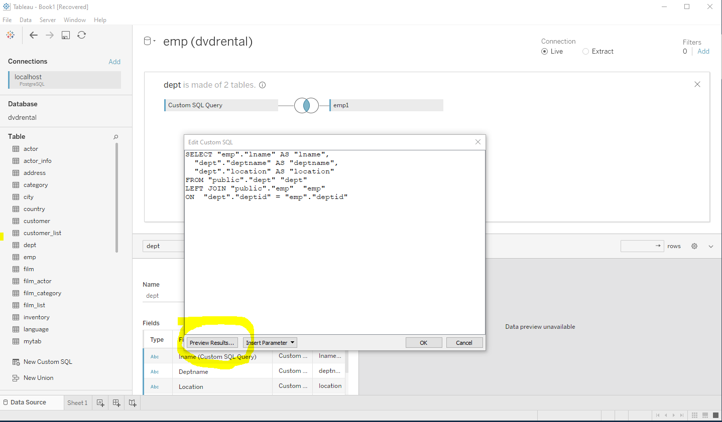
Click Preview Results to see your table data.
https://help.tableau.com/current/pro/desktop/en-us/customsql.htm
Notes:
Here is an example of the db-fiddle.com environment. You can use db-fiddle.com in virtually any web browser. Remember to save your work in notepad.

Slide 26
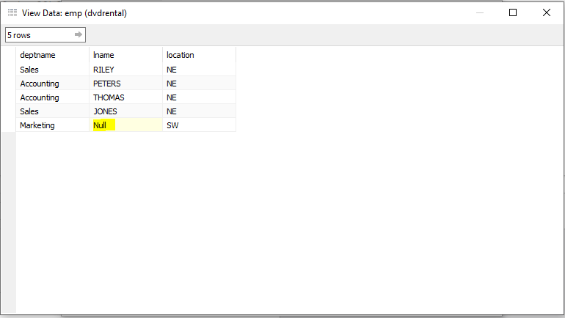
RESULTS OF AN OUTER JOIN IN TABLEAU
https://help.tableau.com/current/pro/desktop/en-us/customsql.htm
Notes:
Here is an example of the db-fiddle.com environment. You can use db-fiddle.com in virtually any web browser. Remember to save your work in notepad.

Slide 27
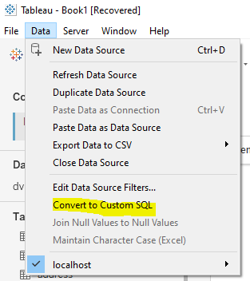
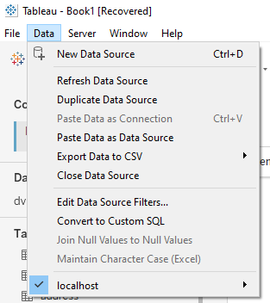
Selecting Custom SQL from the Data Menu Item
https://help.tableau.com/current/pro/desktop/en-us/customsql.htm
Notes:
Here is an example of the db-fiddle.com environment. You can use db-fiddle.com in virtually any web browser. Remember to save your work in notepad.

Slide 28
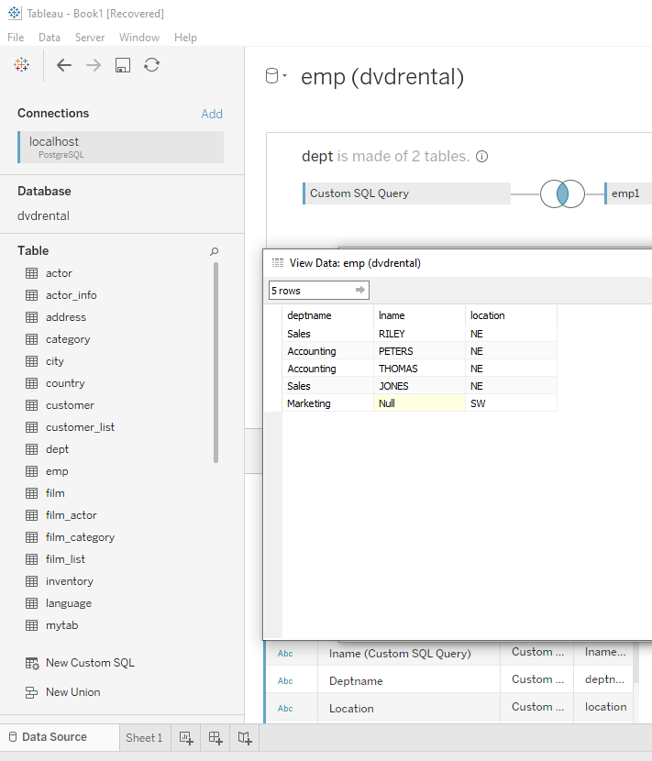
Click Preview Results to see your table data.
https://help.tableau.com/current/pro/desktop/en-us/customsql.htm
Notes:
Here is an example of the db-fiddle.com environment. You can use db-fiddle.com in virtually any web browser. Remember to save your work in notepad.

Slide 29
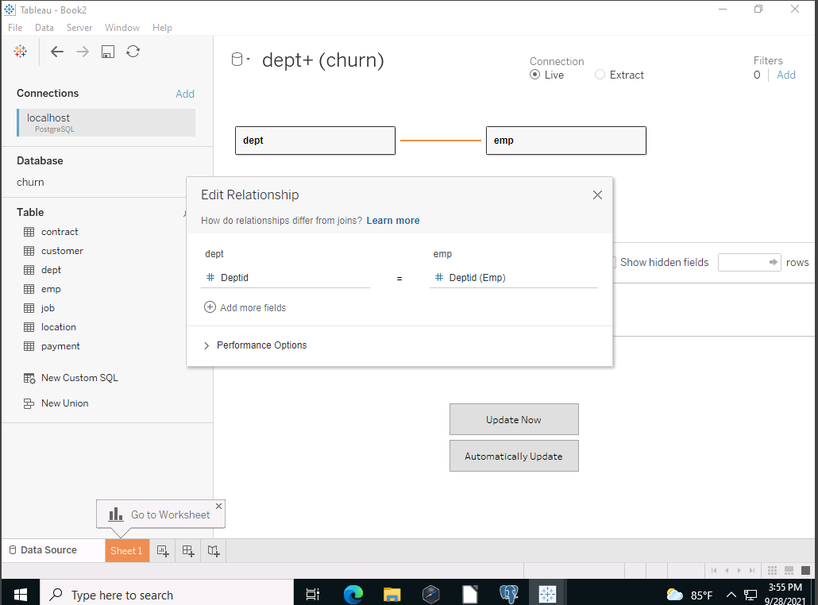
CREATING A CUSTOM SQL QUERY IN TABLEAU
https://help.tableau.com/current/pro/desktop/en-us/customsql.htm
Notes:
Here is an example of the db-fiddle.com environment. You can use db-fiddle.com in virtually any web browser. Remember to save your work in notepad.

Slide 30
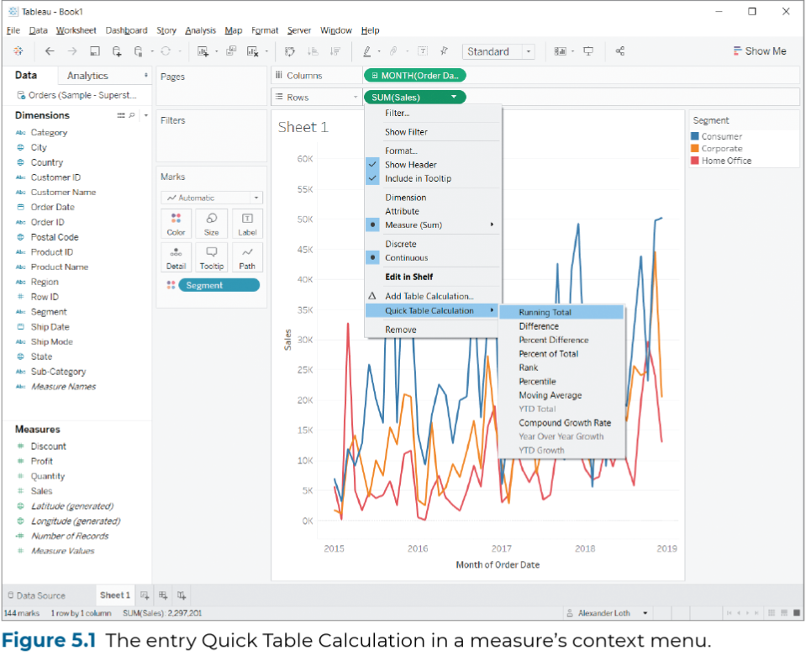
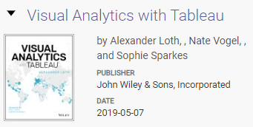
Link to Textbook
Notes:
Here is an example of the db-fiddle.com environment. You can use db-fiddle.com in virtually any web browser. Remember to save your work in notepad.

Slide 31
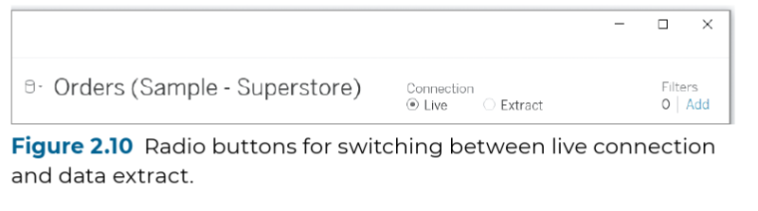

Link to Textbook
Notes:
Here is an example of the db-fiddle.com environment. You can use db-fiddle.com in virtually any web browser. Remember to save your work in notepad.

Slide 32
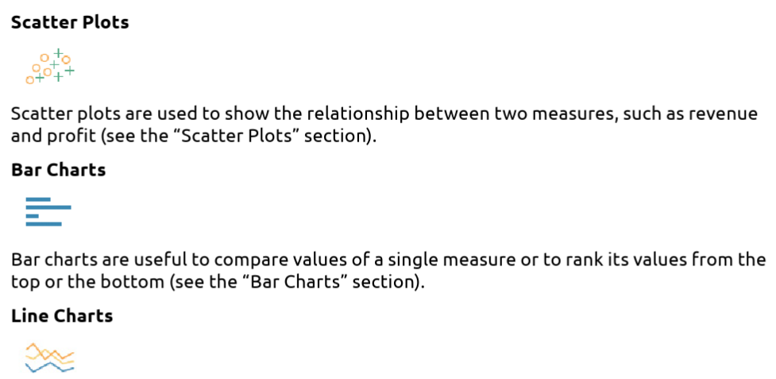
Notes:
Here is an example of the db-fiddle.com environment. You can use db-fiddle.com in virtually any web browser. Remember to save your work in notepad.

Slide 33
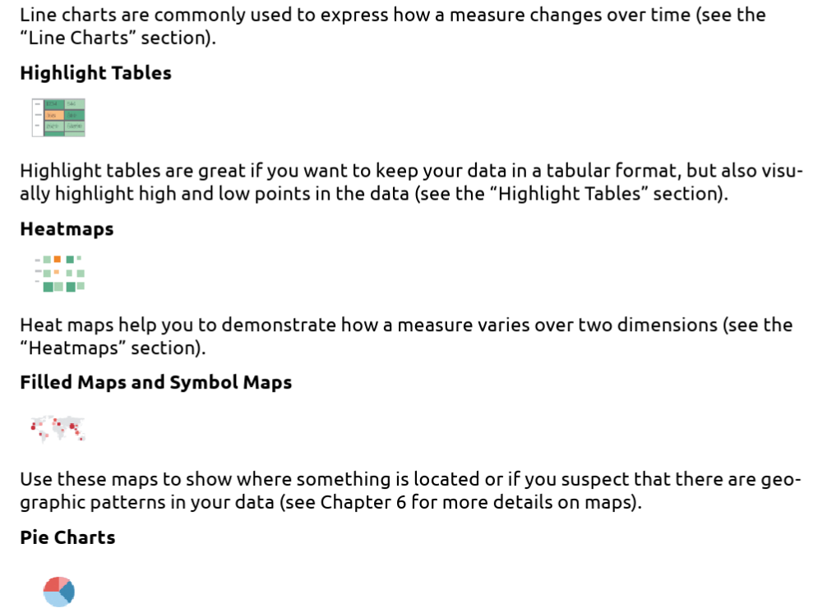
Notes:
Here is an example of the db-fiddle.com environment. You can use db-fiddle.com in virtually any web browser. Remember to save your work in notepad.

Slide 34
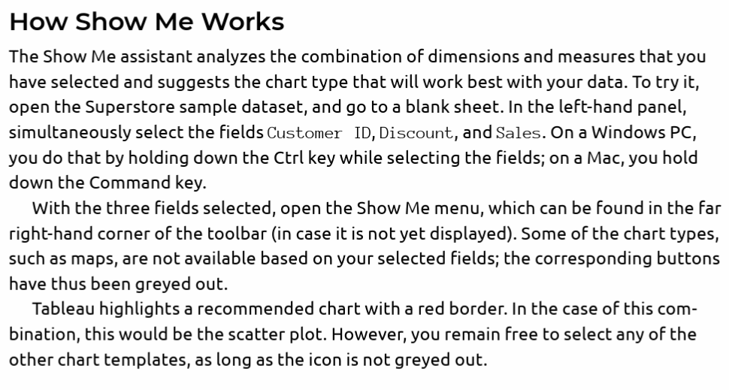
Notes:
Here is an example of the db-fiddle.com environment. You can use db-fiddle.com in virtually any web browser. Remember to save your work in notepad.

Slide 35
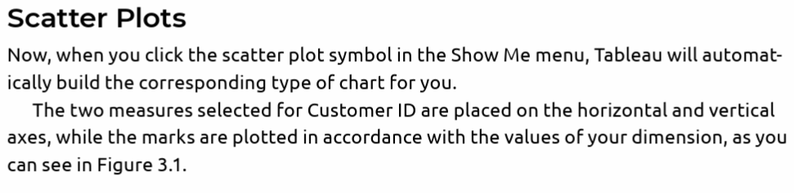
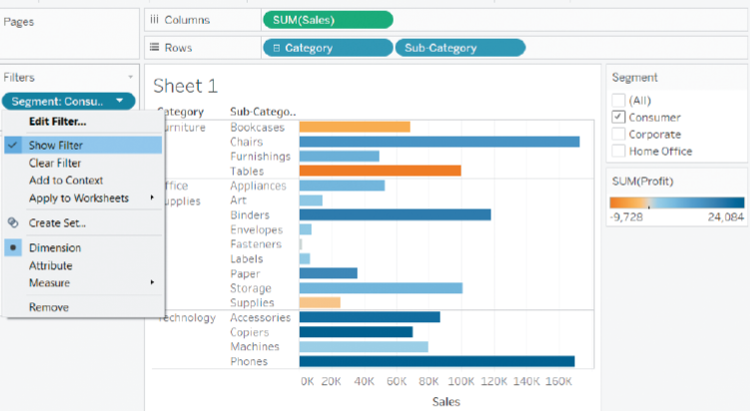
A filter for a bar chart →
Notes:
Here is an example of the db-fiddle.com environment. You can use db-fiddle.com in virtually any web browser. Remember to save your work in notepad.

Slide 36
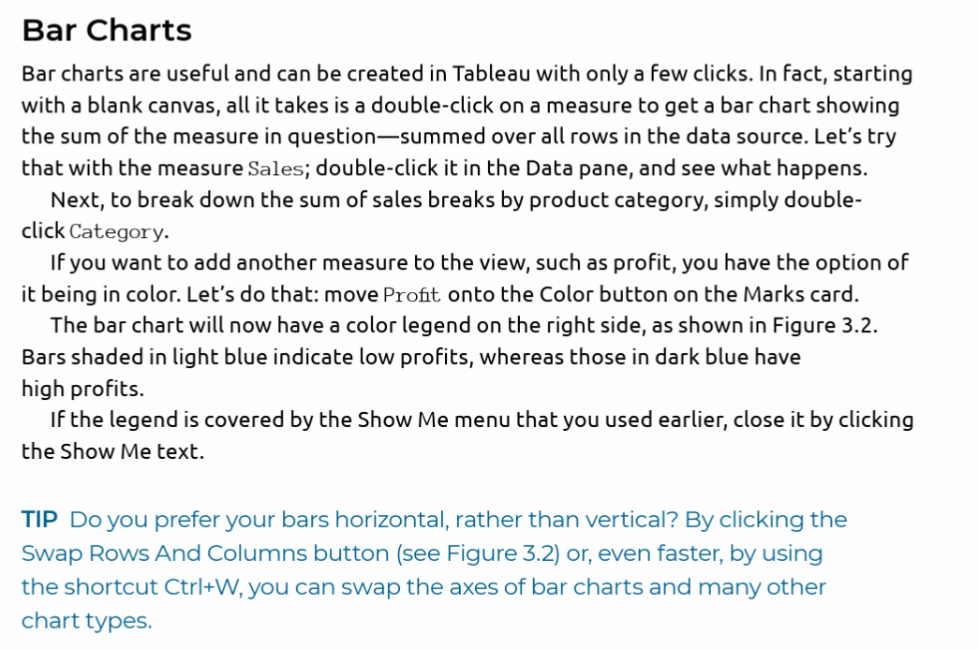
Notes:
Here is an example of the db-fiddle.com environment. You can use db-fiddle.com in virtually any web browser. Remember to save your work in notepad.

Slide 37
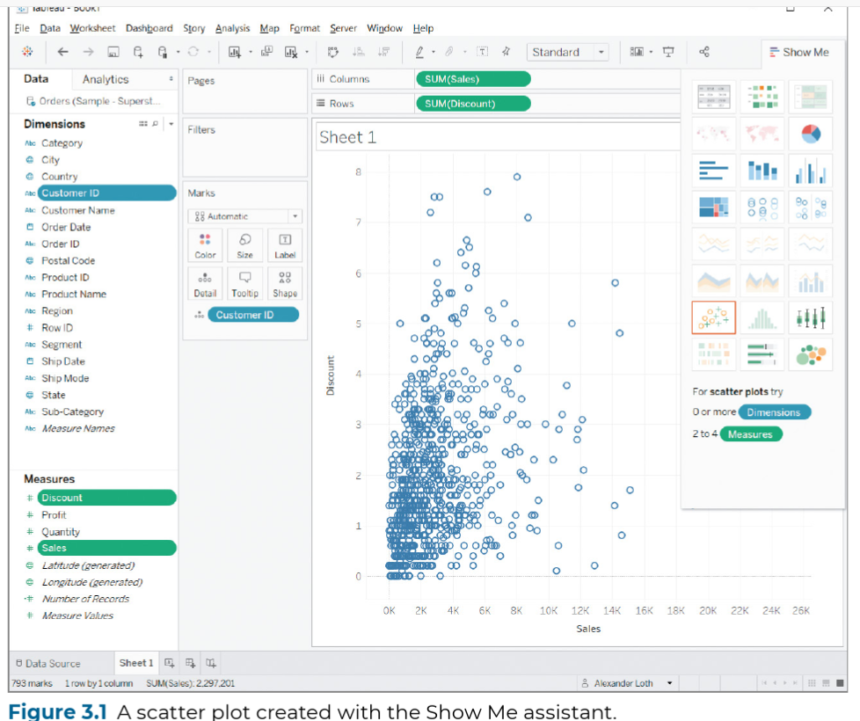
From page 85
Notes:
Here is an example of the db-fiddle.com environment. You can use db-fiddle.com in virtually any web browser. Remember to save your work in notepad.

Slide 38
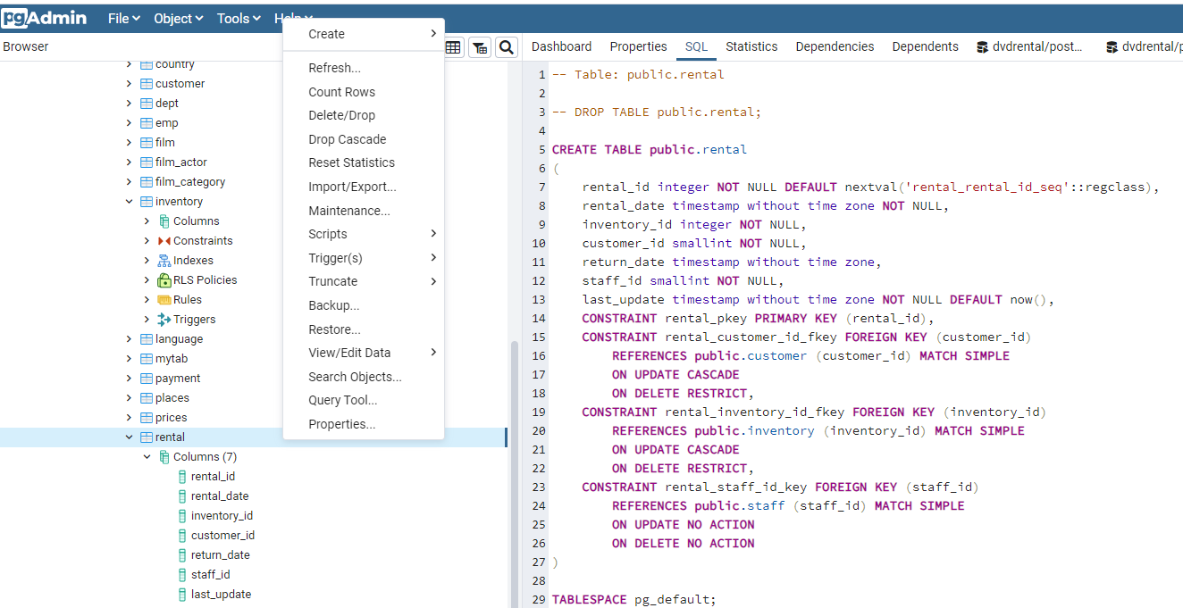
Notes:
Here is an example of the db-fiddle.com environment. You can use db-fiddle.com in virtually any web browser. Remember to save your work in notepad.

Slide 39
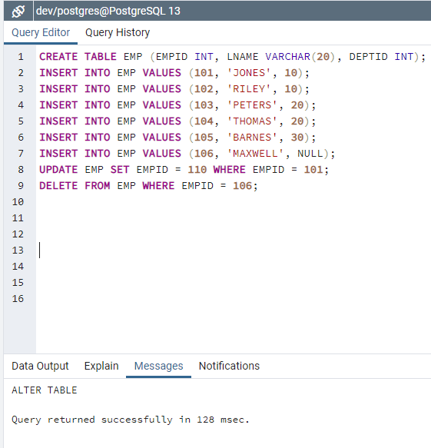
Notes:
Here is an example of the db-fiddle.com environment. You can use db-fiddle.com in virtually any web browser. Remember to save your work in notepad.

Slide 40
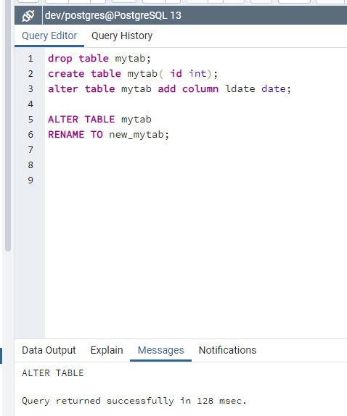

Notes:
Here is an example of the db-fiddle.com environment. You can use db-fiddle.com in virtually any web browser. Remember to save your work in notepad.

Slide 41
Group By Rules
Group By clauses can be confusing to beginning SQL coders. When do you use a group by and when not to use it?
Select count(employee_id) from employee; ← Group By not needed.
Select sum(salesamt), max(salesamt), min(salesamt) from sales; ← Again, Group by is not needed.
Select deptname, sum(salesamt), count(salesamt) from sales Group By deptname; ← Here it is needed.
Why? Because in a Select clause if all of the columns are aggregated then a Group By is not needed. In essence, there is no “grouping” occurring. But, if you are combining sales and counting sales by deptname then you are “grouping” and you must perform a Group By on the deptname column.
You can have compound group, say, by region and department like this:
Select regionName, deptName, sum(salesamt) from sales Group By regionName, deptName;
You can also use numbers for the positions of the Group By and Order By columns that are listed in the Select clause.
Group By Rules
Group By clauses can be confusing to beginning SQL coders. When do you use a group by and when not to use it?
Select count(employee_id) from employee; ← Group By not needed.
Select sum(salesamt), max(salesamt), min(salesamt) from sales; ← Again, Group by is not needed.
Select deptname, sum(salesamt), count(salesamt) from sales Group By deptname; ← Here it is needed.
Why? Because in a Select clause if all of the columns are aggregated then a Group By is not needed. In essence, there is no “grouping” occurring. But, if you are combining sales and counting sales by deptname then you are “grouping” and you must perform a Group By on the deptname column.
You can have compound group, say, by region and department like this:
Select regionName, deptName, sum(salesamt) from sales Group By regionName, deptName;
You can also use numbers for the positions of the Group By and Order By columns that are listed in the Select clause.

Slide 42
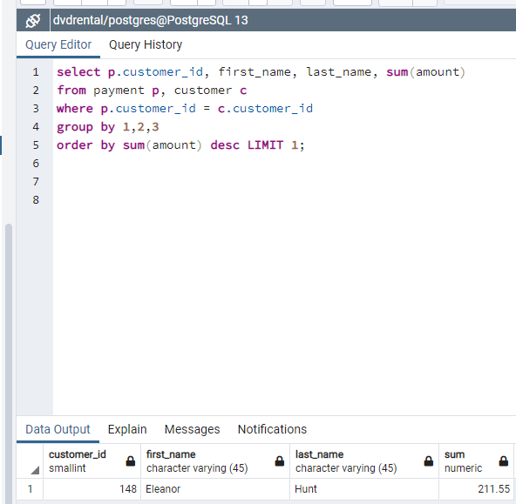
Group By Rules
Group By clauses can be confusing to beginning SQL coders. Here, we are joining two tables
Then grouping by the non-aggregated
Columns. Notice how we group them
And use limit to return only the first
Value after ordering descending.

Slide 43
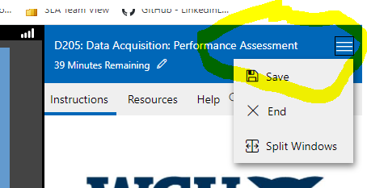
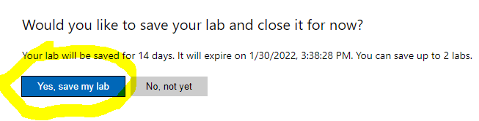
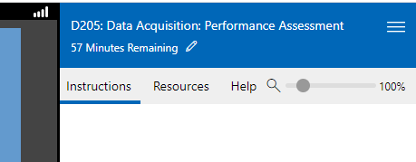
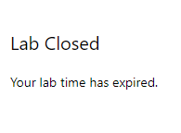
On the left Bringing PgAdmin back to life
On the right side, click the three parallel bars to save your session.’
Bringing PgAdmin back to life and Saving your session.
← Watch the clock! →
Notes:
In the upper left corner, use display or lightning bolt to bring PgAdmin back to life. Upper right corner, save your session.

Slide 44
Links to the Churn Tables:
Contract
customer
job
location
payment
services
survey_responses
Links to the Medical Tables:
admission
complication
job
location
patient
servicesaddon
survey_responses_addon
Ancillary Files:
Take 5 Loading Tables
MovingFilesTo_From_VM
In this Take Five video, I cover how to import data from a CSV file into a Postgres table
If you want to see the queries that Tableau is doing for you
under the covers, you can find them in either of these articles:
https://kb.tableau.com/articles/howto/viewing-underlying-sql-queries-desktop
https://blog.openbridge.com/7-steps-to-export-sql-statements-from-tableau-7e51a2fd4277
Notes:
Here is an example of the db-fiddle.com environment. You can use db-fiddle.com in virtually any web browser. Remember to save your work in notepad.

Slide 45
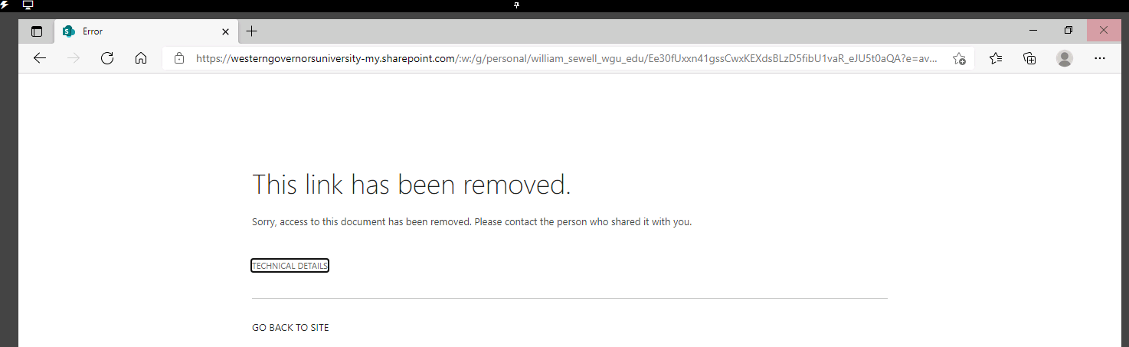
MOVING FILES TO AND FROM THE LABS ON DEMAND DESKTOP
There are two ways to upload or download files to and from the VM (Labs on Demand).
First method
Step 1. Email files to yourself using a Yahoo or Gmail email account.
Step 2 Log on to the virtual desktop.
Step 3. Open a browser on the virtual desktop.
Step 4. Connect to your Yahoo or Gmail account.
Step 5. Open your email and access your files, save to the desktop.
Second Method:
Step 1. Open a browser.
Step 2. Type in a shared document link. (You can create this link as a Microsoft OneDrive link by clicking on the file and sharing it).
Step 3. You will see the following screen.
Notes:
Here are links to the data as well as how to import and to transfer files to and from the Labs on Demand and your PC.

Slide 46
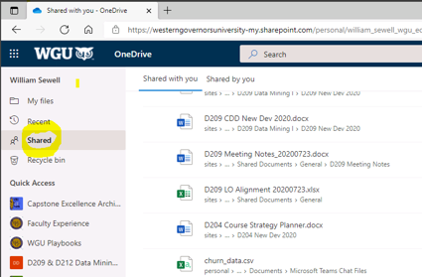
So, the trick is when the error page appears like above, just click the small link "Go back to site".
Then, it will prompt you to login with your WGU credentials. Next, select Shared files
(like the screenshot below) and navigate to the file you want to upload to the VM.
Notes:
Here are links to the data as well as how to import and to transfer files to and from the Labs on Demand and your PC.

Slide 47
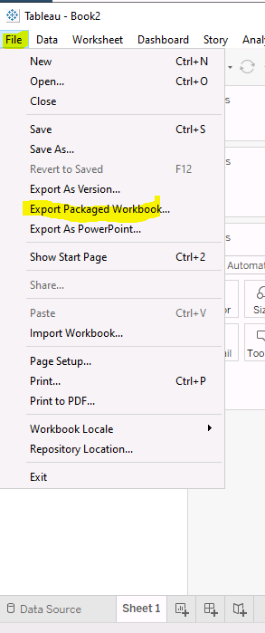

BE SURE TO SAVE AND TURN IN YOUR DASHBOARD AS A .TWBX

Slide 48
TESTIMONIALS
“ Thank you so much for the detailed tips in Webinar and the wonderful notes.” AC .
“ really helped me to understand the concepts and pass on the first attempt!” Sharon B.
“I can’t believe how the webinars really helped me understand databases!” Mark F.
“Everybody should study these webinars. They are exactly what you need to learn.” John C.
“Before I took this course, I did not know any SQL. Based on the course and your webinars I have learned so much!” James G.
“These Webinars were a life-saver for me! Thanks so much, Dr. Sewell!” Thomas P.
“If you don’t know anything about databases, this is the place to start! Great videos and slides.” Jessica V.
“Thanks for pointing out chapter 3 and the SHOW ME feature. I really missed it.” Shirley B.
“I needed to learn how to move files to and from the Labs on Demand. Your document tells it all.” Danielle H.

Slide 49


Dr. William Sewell
Course Instructor
College of Information Technology
Western Governors University
877-435-7948 ext 5377 or (385) 428-5377
Text me at: 954-802-2225
4001 South 700 East, Suite 700
Salt Lake City, UT 84107
william.sewell@wgu.edu
Appointments
Don’t forget I am only a phone call, away!
Notes:
No matter how far away.

